Slide 1


TOWN HALL January 28, 2020 Ford Center Reception Hall
Mayor Al Thurman
Mayor Pro-Tem Council Member Henry Lust, Ward 1
Council Member Doris Dawkins, Ward 2
Council Member Nancy Farmer, Ward 3
Council Member Patrick Bordelon, Post 1 – At Large
Council Member Patricia Wisdom, Post 2 – At Large

Slide 2
Financial Reports
FY 19 CAFR SUMMARY
FY 20 STATUS

Slide 3

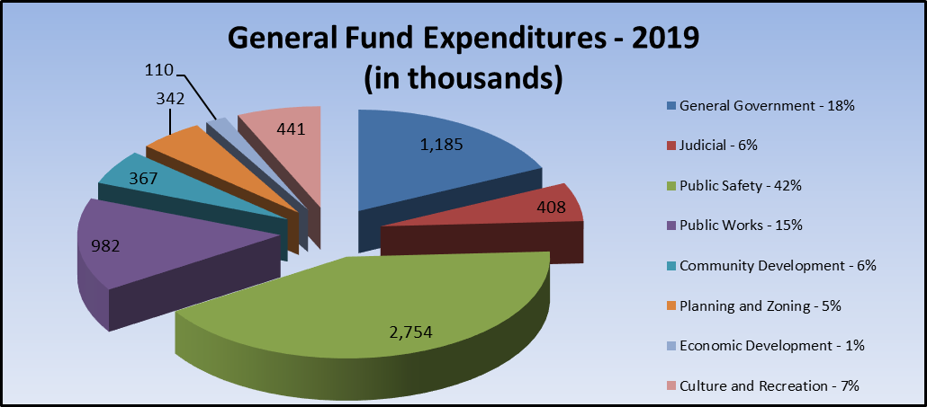
Fiscal Year Ending June 30, 2019

Slide 4
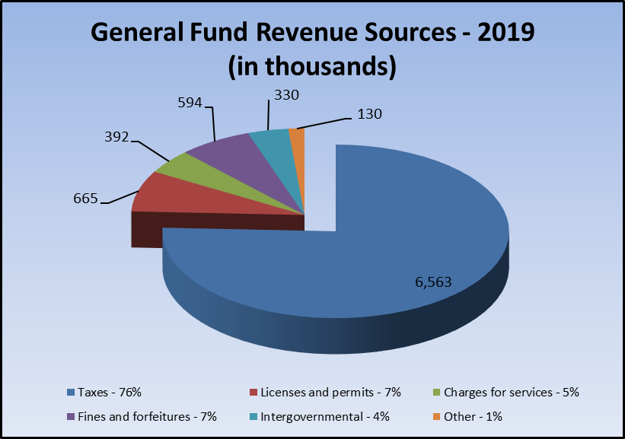
Fiscal Year Ending June 30, 2019

Slide 5
General Fund - Fund Balance

Slide 6
FY 21 BUDGET
TIMELINE
OVERVIEW

Slide 7
FY21 Budget Calendar
January 6, 2020 City Manager Finalizes the Budget Calendar and meets with Department Directors to discuss the process for the upcoming Operating and Capital Budgets; Budget Worksheets Distributed.
January 28, 2020 State of the City Town Hall and Budget Kickoff
February - March Budget preparations
April 14, 2020 Town Hall
April 29, 2020 City Manager Presentation of Proposed FY 21 Budget
May 5 & 7, 2020 Budget Open House
May 18, 2020 Mayor and Council-First Reading of Budget Ordinance and Budget Hearing
June 1, 2020 Mayor and Council-Second Reading of Budget Ordinance and Budget Hearing
June 1, 2020 Mayor and Council-Budget Adoption
July 1, 2020 Budget Implementation

Slide 8


Slide 9
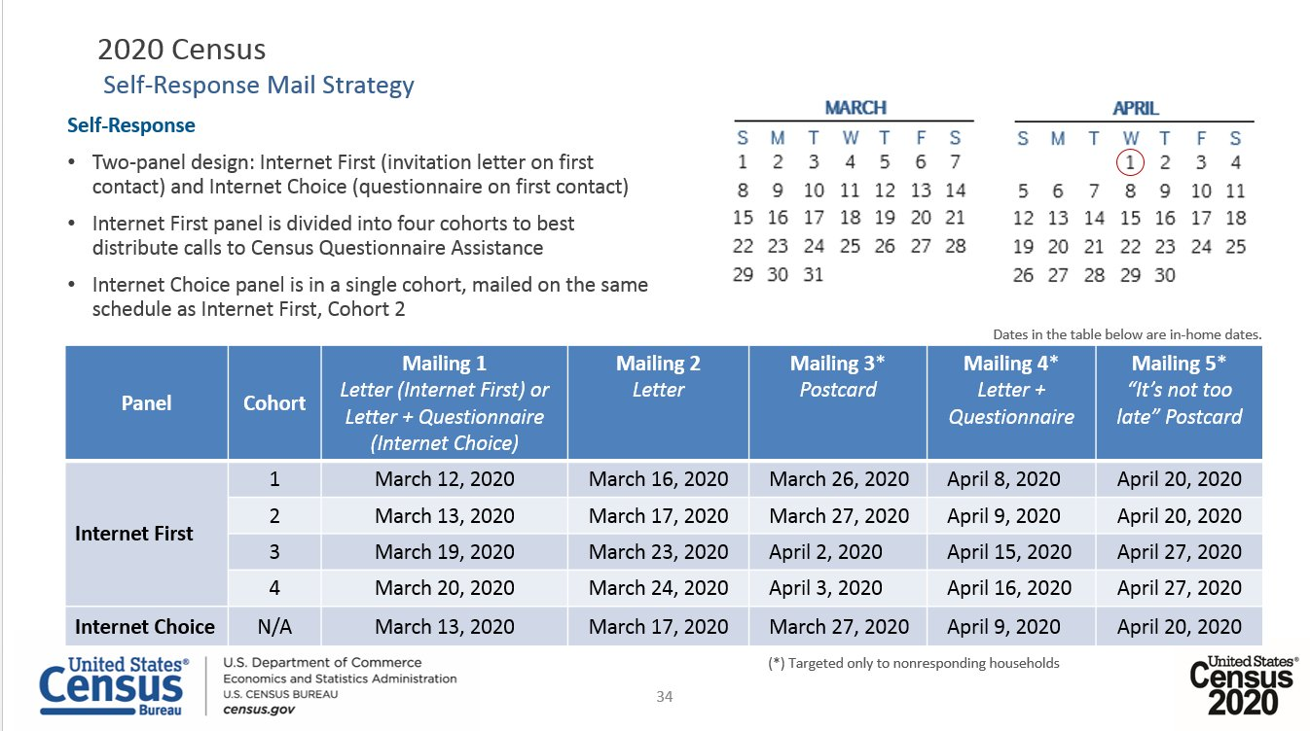
Self-Response Mailing Dates

Slide 10
DEVELOPMENT UPDATE
& capital projects

Slide 11
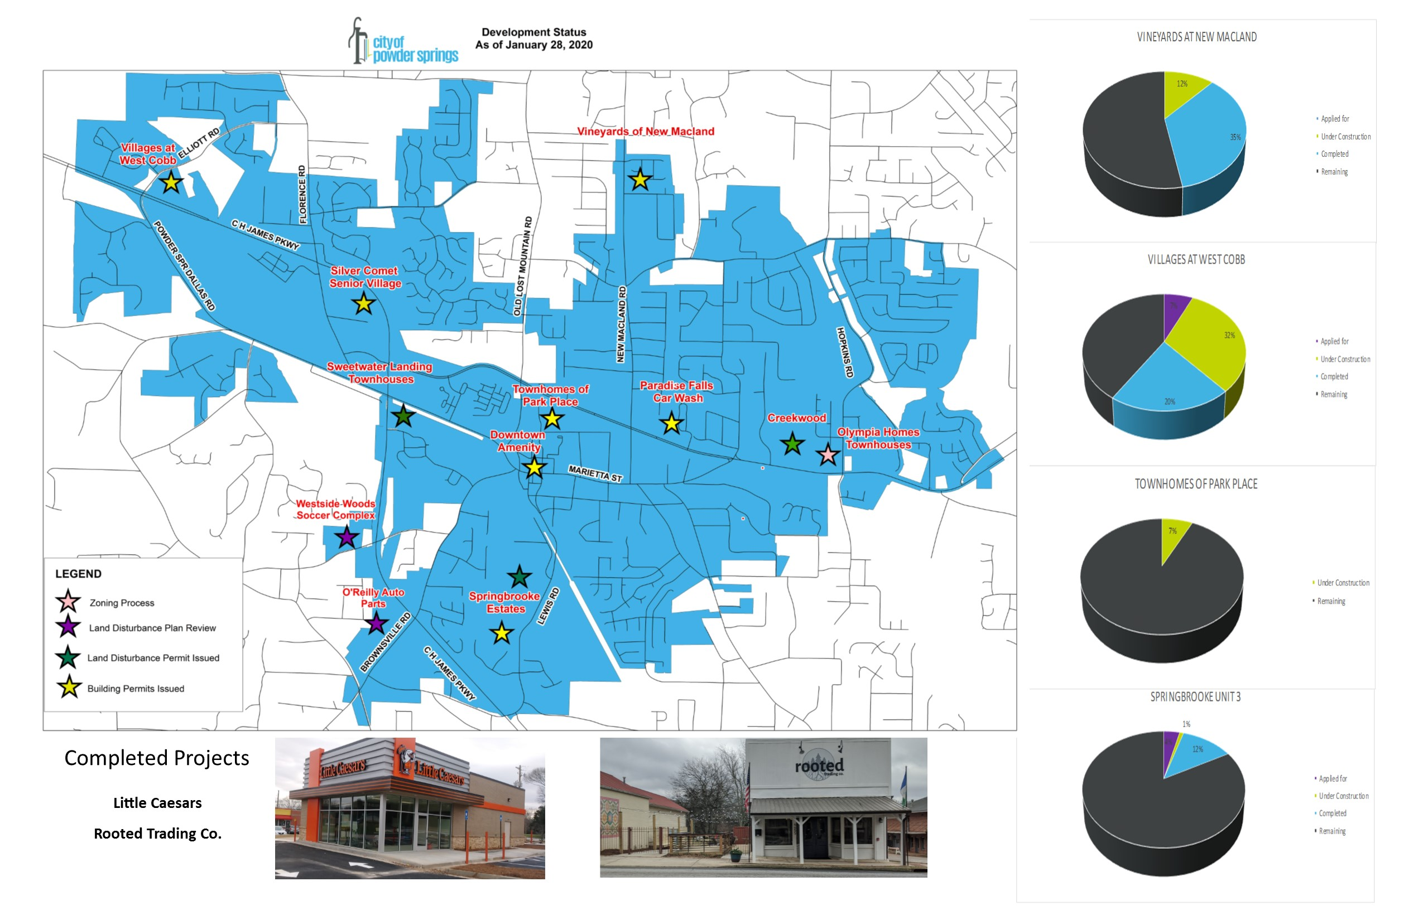

Slide 12
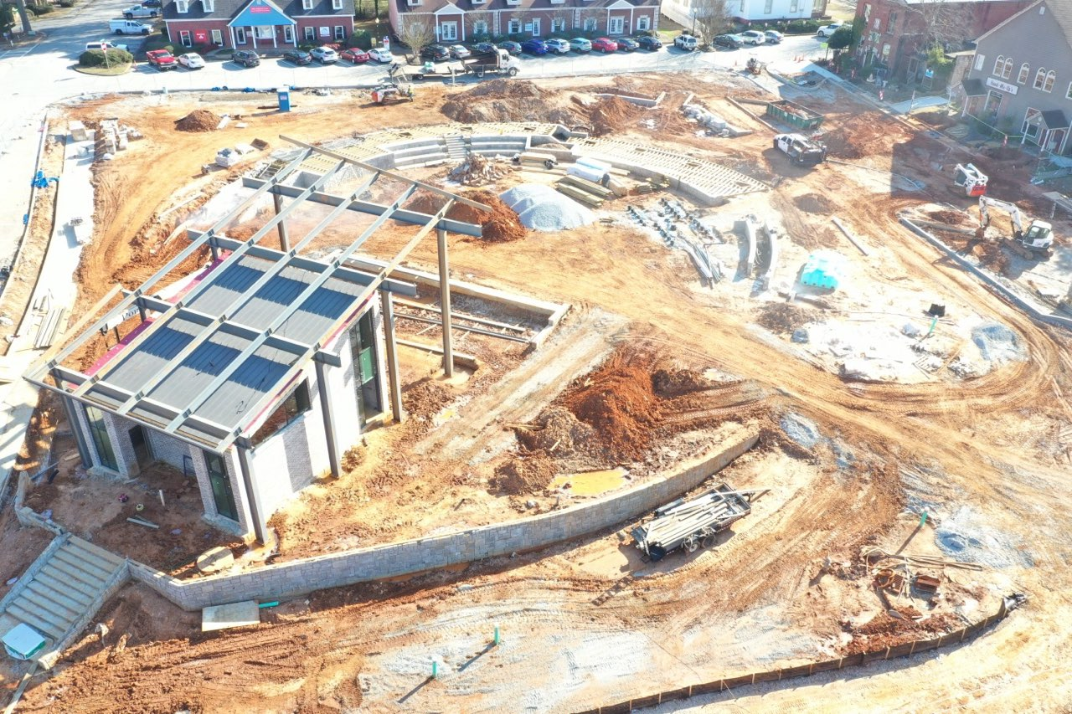

Slide 13
SPLOST 2016
2019 and remaining projects

Slide 14
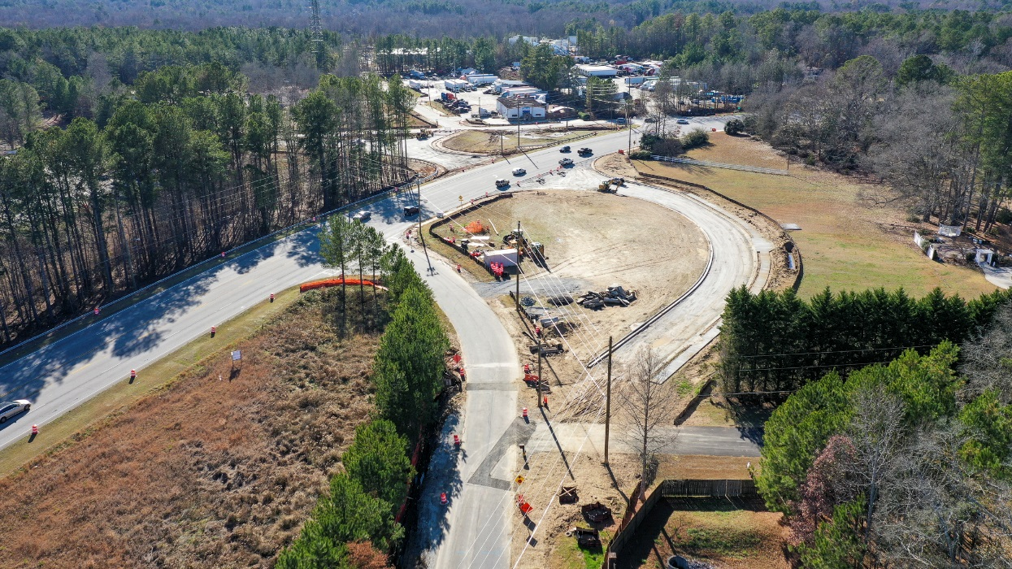
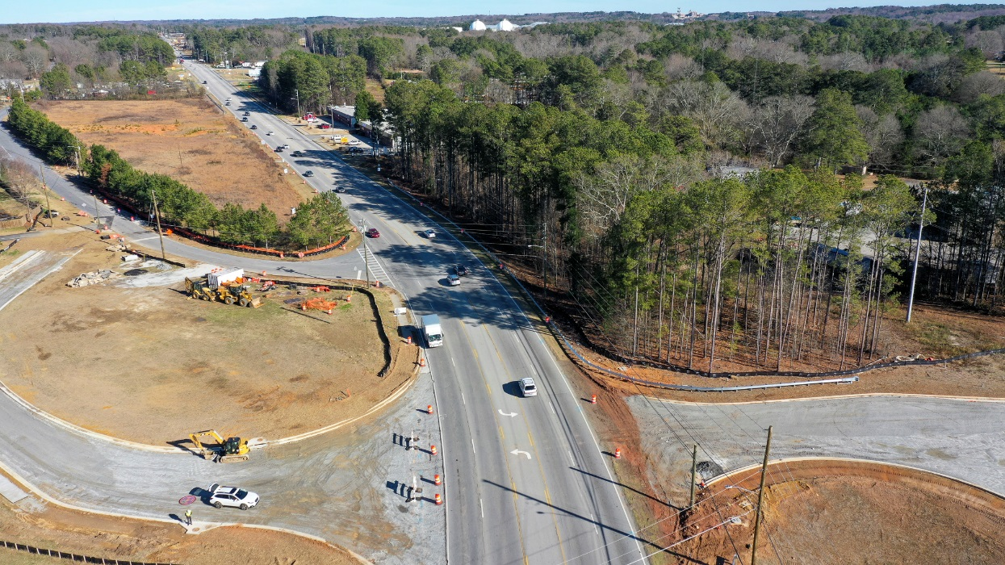
Flint Hill & Pinegrove Intersection
CW Matthews
$2.6M
Completion expected April 2020

Slide 15
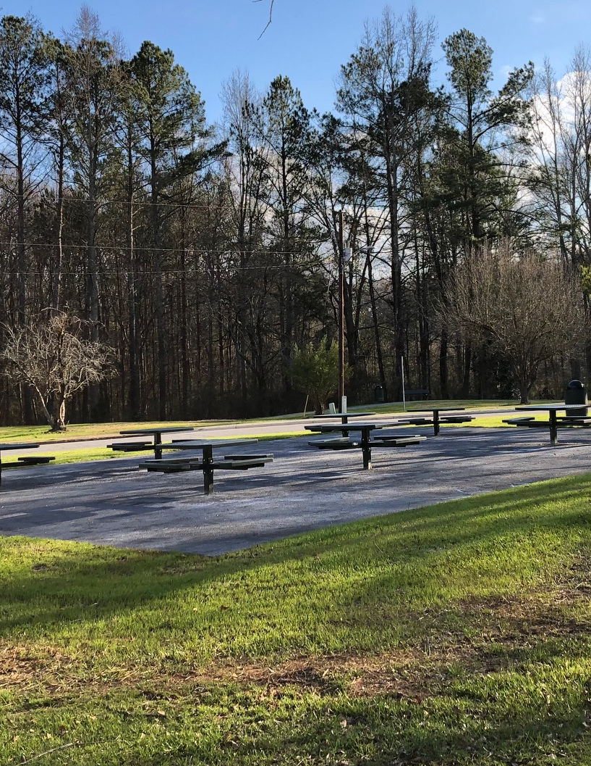
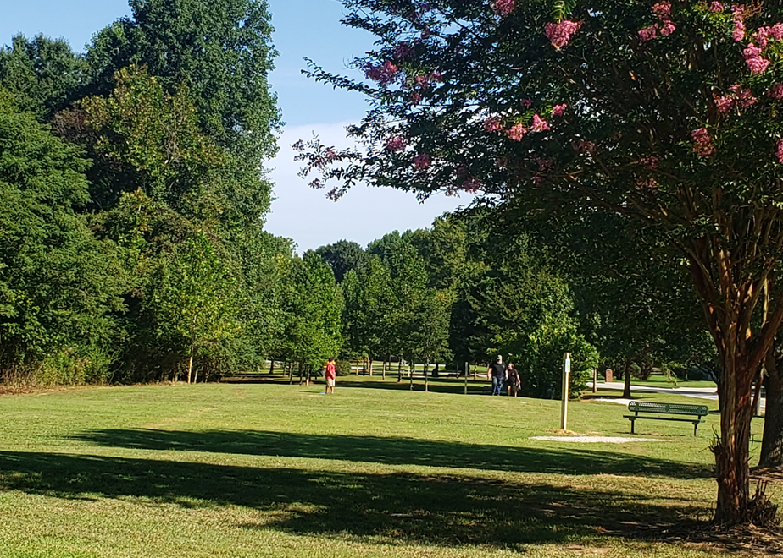
Neighborhood Pocket Parks
Hopkins Road
Lancer Drive

Slide 16
Remaining 2016 projects
Intersection Improvements
Sailors & 278
Sailors & Forest Hill
Florence & 278
Dallas Powder Springs & Florence

Slide 17
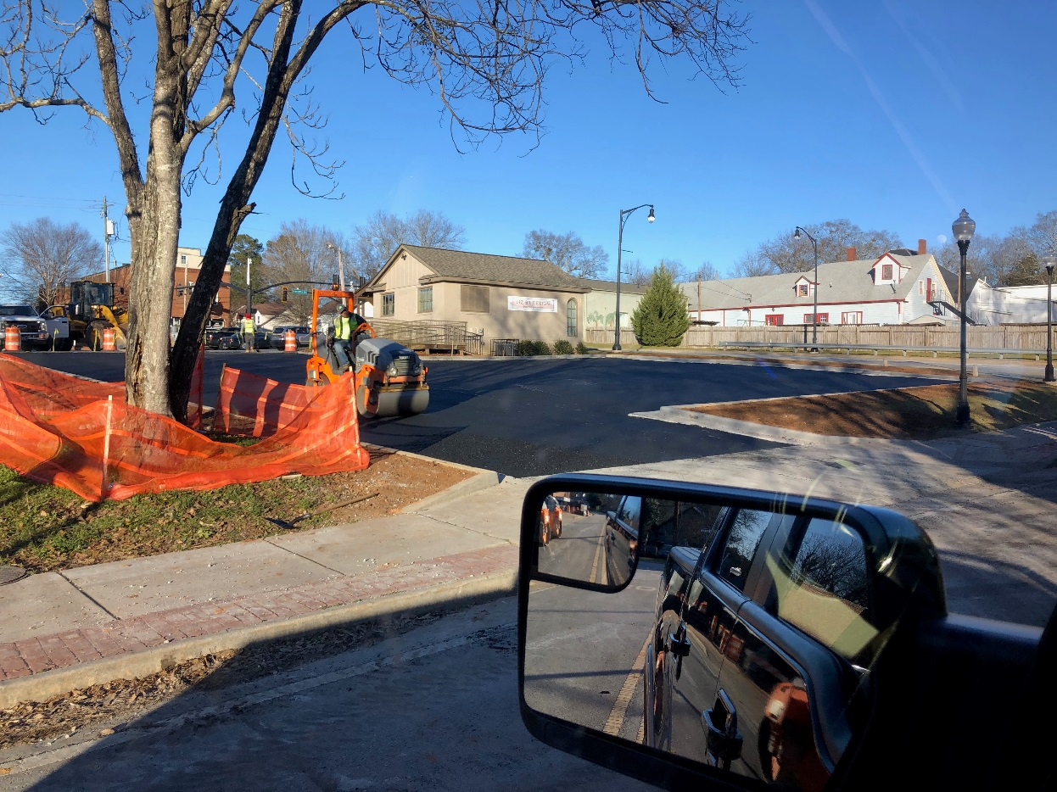
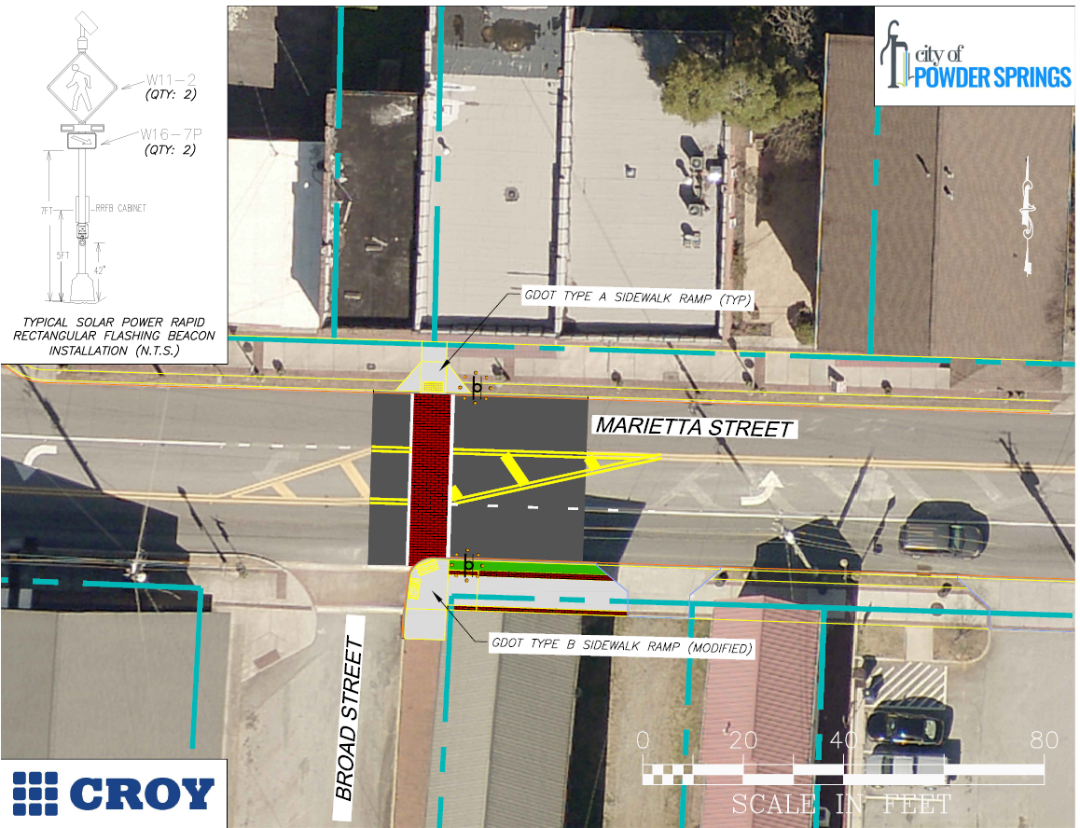
General Streets & parking improvements

Slide 18
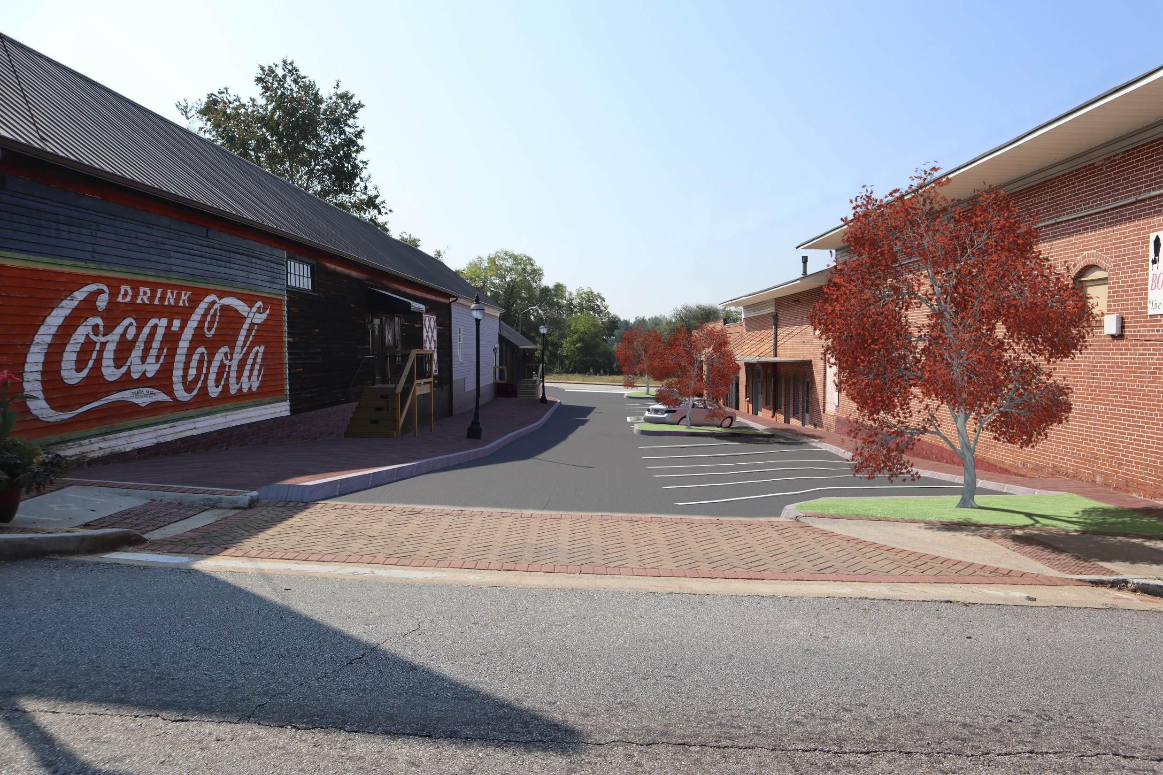
Broad Street Streetscape & Crosswalk

Slide 19
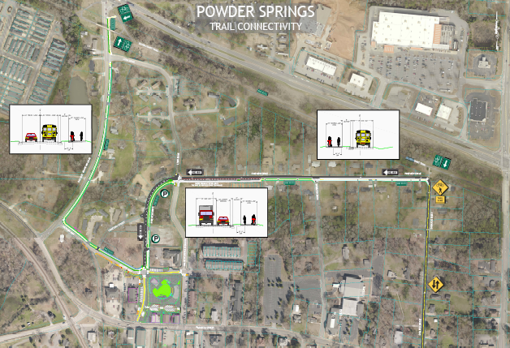
General Streets & resurfacing
Pineview trail connectivity
Brownsville Road Streetscape
Parking improvements Jackson Way, Oakview and Murray

Slide 20

SPLOST 2022
City of Powder Springs
Town Hall Meeting
January 28, 2020

Slide 21
What is a Special Purpose Local Option Sales Tax (SPLOST)?
A SPLOST is an optional 1% county sales tax used to fund capital outlay projects proposed by the county government and participating qualified municipal governments.
The tax is imposed through a referendum by the county board of commissioners.
The tax is collected on items subject to sales and use tax within the county.
The tax may be imposed for up to 6 years.
Notes:
SPLOST funds generally cannot be used for operating expenses, maintenance and repair of SPLOST project or any other county/city facility/service. (except for streets, roads, and bridges.)
* 6 years with intergovernmental agreement, 5 years without
Current SPLOST expires on December 31, 2021.
Cobb – 30% of SPLOST funds have come from outside the county.

Slide 22
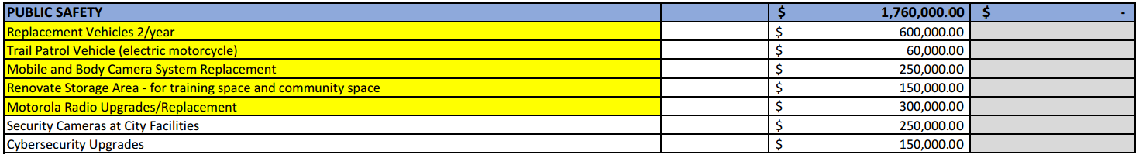
Powder Springs Proposed Projects Public Safety
City Portion County Portion
Notes:
Highlight – City Council identified priorities
Amounts in column with “County Portion” are proposed joint projects with the county.
Handouts available

Slide 23
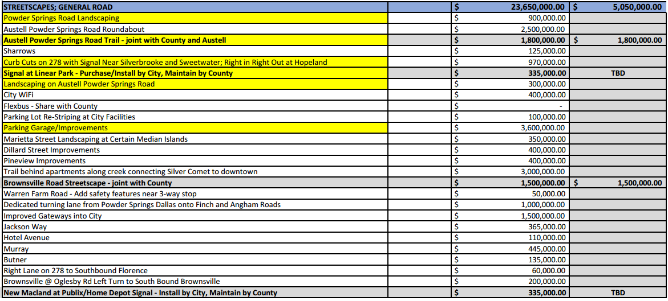
Powder Springs Proposed Projects Transportation
City Portion County Portion

Slide 24
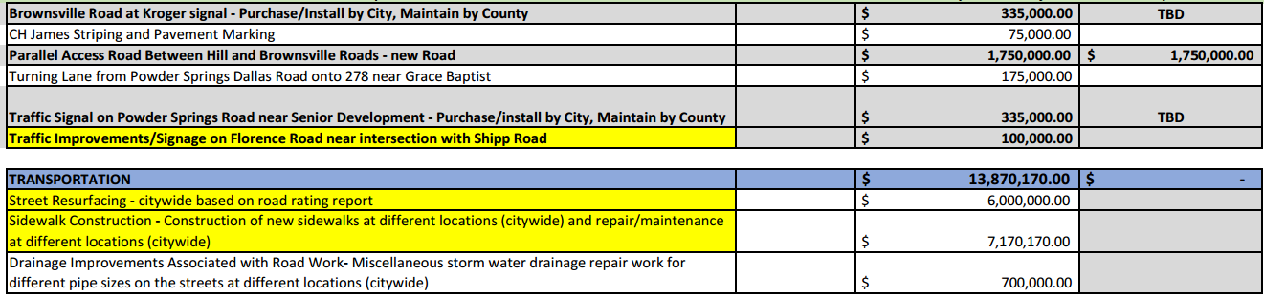
Powder Springs Proposed Projects Transportation
City Portion County Portion

Slide 25
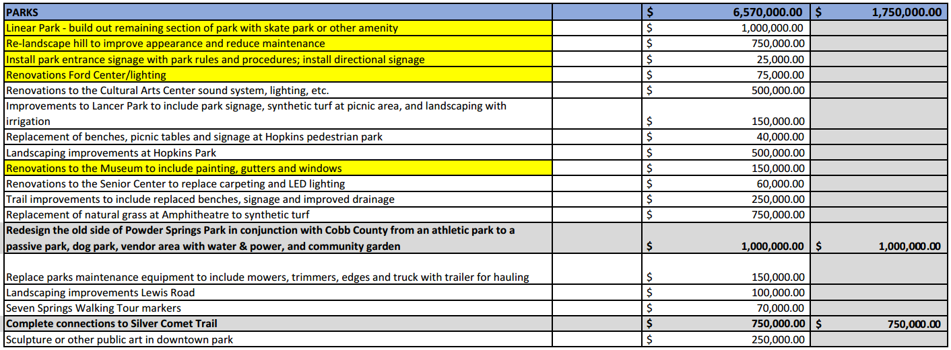
Powder Springs Proposed Projects Parks, Facilities & Capital Equipment
City Portion County Portion

Slide 26
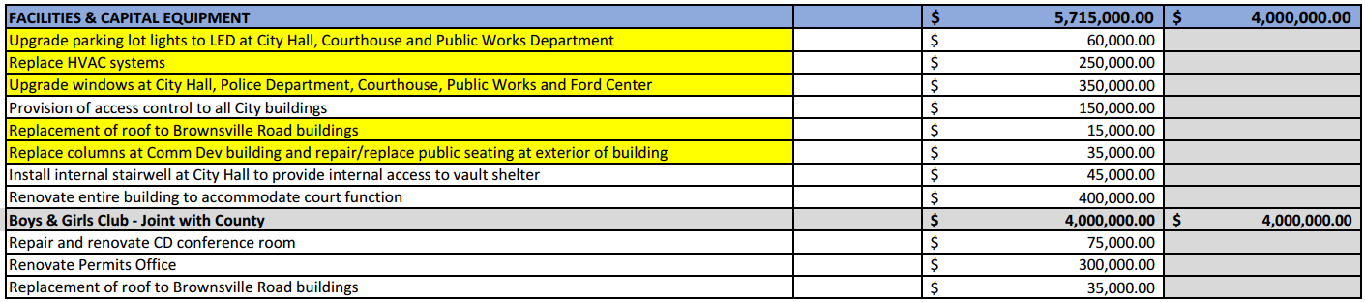
Powder Springs Proposed Projects Parks, Facilities & Capital Equipment
City Portion County Portion

Slide 27
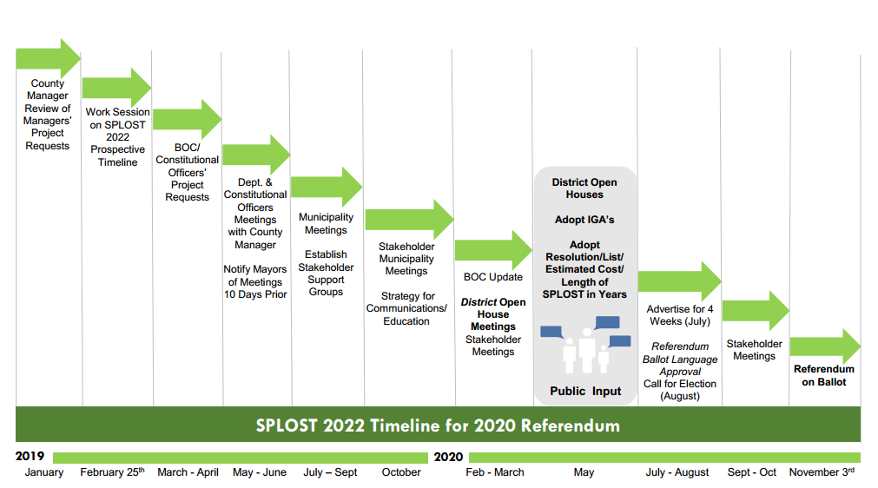
Cobb County SPLOST 2022 Timeline
Notes:
Cobb County BOC are still deciding on the length of time to impose the tax for SPLOST 2022. Also still identifying the portion allocated to each city.
Timeline shared by the BOC at their SPLOST retreat in October. Currently in the middle of the timeline. City elected officials will be working with the county to finalize the lists by May 2020.
Referendum for SPLOST 2022 will be on the election ballot for November 3, 2020.

Slide 28
Mayor and Council Updates

Slide 29
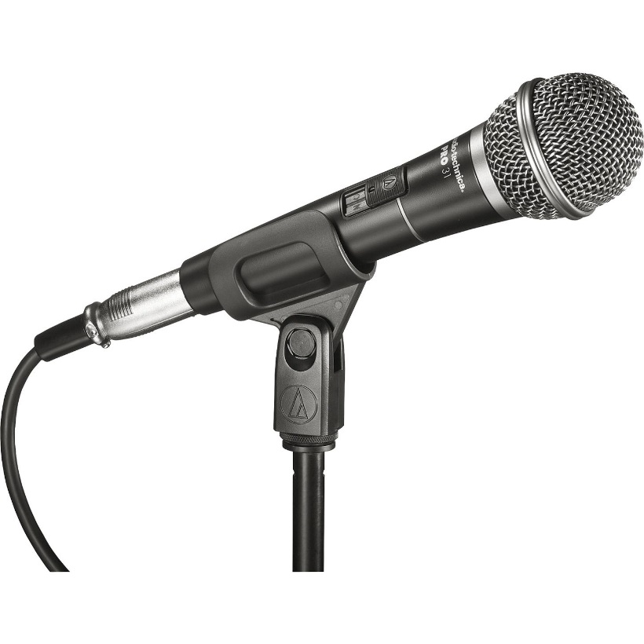

Questions and Answers
PLEASE SPEAK INTO THE MICROPHONE FOR THE BENEFIT OF OUR STREAMING VIEWERS

